Slide 1


ETHICAL ISSUES IN ARTIFICIAL INTELLIGENCE APPLIED TO MEDICINE
Cemal H. Guvercin, MD, PhD
Division of Developmental Medicine
Boston Childrens Hospital, Harvard University
Boston, MA, US

Slide 2
What is the Artificial Intelligence (AI)
AI can be defined as an area of computer science that emphasizes the creation of intelligent machines the automatization of the activities which are related to human thinking such as learning, problem solving and decision making.
The ability of the AI methods to reveal significant relations in data sets are used to diagnose, treat and predict the outcomes in many clinical scenarios.

Slide 3
Time Line
Academic $ academic and routine
Renaissance
50 60 70 80 90 00 10
1956 Dartmouth conference.
1981 Japanese Fifth Generation project launched as the
Expert Systems age blossoms in the US.
1988 AI revenues peak at $1 billion.
2000s can be considered as Renaissance of the AI

Slide 4
The Difference Between Natural and Artificial Intelligence
Ability to | Natural Intelligence (Human) |  | Artificial Intelligence (Machine)
 | Low | High | Low | High
Use sensors (eyes, ears, touch, smell) |  | √ | √
Be creative and imaginative |  | √ | √
Learn from experience |  | √ | √
Adopt to new situations |  | √ | √
Afford the cost of acquiring intelligence |  | √ | √
Acquire a large amount of external information |  | √ |  | √
Use a variety of information sources |  | √ |  | √
Make complex calculations | √ |  |  | √
Transfer information | √ |  |  | √
Make a series of calculations rapidly and accurately | √ |  |  | √

Slide 5
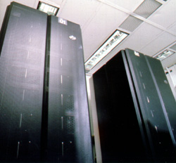
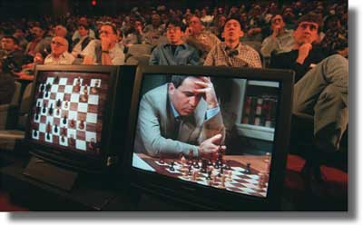
The Man vs The Machine
In 1997, Deep Blue beat Gary Kasparov.
The 1997 match was the subject of a documentary film, The Man vs. The Machine

Slide 6
Uses or Applications of AI
Medicine
Military
Space science
Finance
Heavy Industry
Transportation
Online and TCS
Video games
Music

Slide 7
What are the main applications of AI in medicine?
Interpreting and identifying
Predicting
Diagnosing
Designing and planning
Monitoring
Debugging and testing
Instructing and training
Controlling

Slide 8
AI Application Fields in Medicine
Cardiology,
Radiology,
Physical Medicine and Rehabilitation,
Ophthalmology,
ENT
Pharmacology, Pharmaceutical Industry,
Oncology, Molecular Biology and Genetics
Public Health
Pathology
Psychiatry
…….

Slide 9
AI Applications Examples in Medicine
Data mining
Time series analysis of data sets,
Classification of medical images,
Diagnosis of the disease,
Classification of the individuals at risk,
Generating genetic algorithms,
Cancer scanning and diagnosis,
Cost-effectiveness analysis
Telemedicine/telehealth
……….

Slide 10
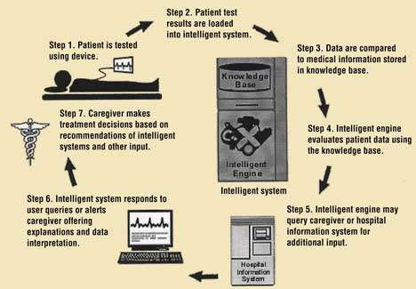
The general structure of an AI application in medicine

Slide 11
Medical Ethics
Medical ethics are the extension of ethics that deal with value-related problems in medical practice.
Principalism suggests four basic principles of medical ethics:
beneficence
non-maleficence
respect for autonomy
justice

Slide 12
Medical Ethics
Technology use in medicine
Tecno-Medicine
Task of technology
Roboethics
Robots rights??

Slide 13
Ethical Issues
Benefit-risk,
Efficiency,
Accessibility,
Cost
Social acceptance

Slide 14
As an Example of AI : Telemedicine
Telecommunication technology
Medicine
Telemedicine

Slide 15
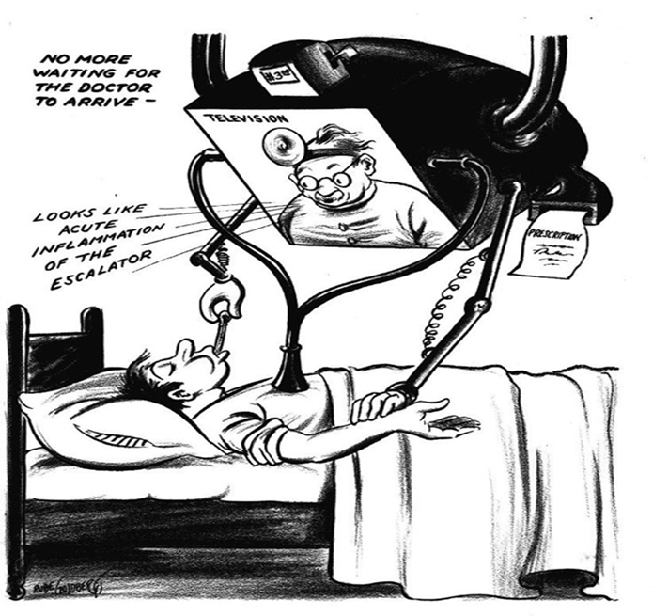
As an Example of AI : Telemedicine
The use of electronic information and communication technologies to provide and support health care when distance separates participants

Slide 16
Telemedicine and Telehealth
Telemedicine
Telehealth
m-Health
Remote Medicine
E-Health
Telecare

Slide 17
Coldeway’s Quadrants
ST SP | DT SP
ST DP | DT DP

Slide 18
Coldeway’s Quadrants
ST/SP
Same Time/Same Place
DT/SP
Different Time/Same Place
ST/DP
Same Time/Different Place
DT/DP
Different Time/Different Place

Slide 19
Telemedicine and Telehealth
Telemedicine is the use of medical information exchanged from one site to another via electronic communications to improve patients' health status. Closely associated with telemedicine is the term "telehealth," which is often used to encompass a broader definition of remote healthcare that does not always involve clinical services.

Slide 20
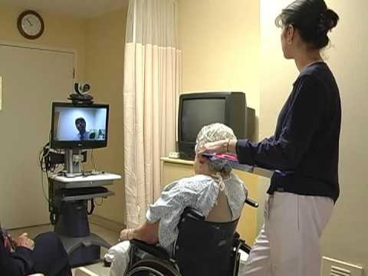

Slide 21
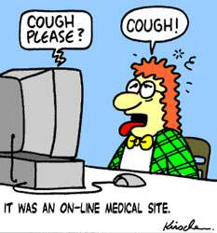
Telemedicine and Telehealth
Videoconferencing,
Transmission of still images,
Remote medicine
E-health including patient portals,
Remote monitoring of vital signs,
Continuing medical education
Nursing call centers
………

Slide 22
Ethical Issue
Risk-benefit
Access security, confidentiality, privacy
Accessibility, social justice
Relationship cyber-physician/nurse and patients

Slide 23
Ethical Issue
Respect the patient rights
Malpractice
Telemedicine in undergraduate education

Slide 24
“The development of full artificial intelligence could spell the end of the human race.”
Stephen Hawking

Slide 25
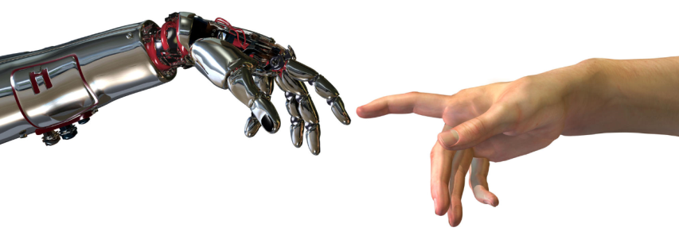
Conclusion
It is certain that all AI applications and also TM can not be without ethics.
Physician-patient relationships must be preserved in the all AI applications.
AI can provide the great benefits for humanity when it used good purposes.
This process be guided by legal and ethical principals, human health, rights, and welfare, rather than profits.

Slide 26
References
Principles of Biomedical Ethics () Tom L. Beauchamp and James F. Childress 5th Ed.
http://www.angelfire.com/ks2/kaz/ai_medicine/timeline.html
http://www.iflscience.com/stephen-hawking-responds-questions-reddit-discusses-ai-and-women
http://www.nap.edu/read/5296/chapter/5
http://www.americantelemed.org/docs/default-source/standards/primary-urgent-care-guidelines.pdf?sfvrsn=4

Slide 27
ETHICAL ISSUES IN ARTIFICIAL INTELLIGENCE APPLIED TO MEDICINE
Cemal H. Guvercin, MD, PhD
Division of Developmental Medicine
Boston Childrens Hospital, Harvard University
Boston, MA, US

